Slide 1
Link State & Hierarchical

Slide 2
Link State Routing
Alternative to Distance Vector
Logic:
Routers share information about their the state of their own links only (Link State).
They share this information with all other routers (flood).
Based on the above information, all routers can compute the full network graph.
Routers run Dijkstra’s algorithm to compute shortest paths to all destinations.

Slide 3
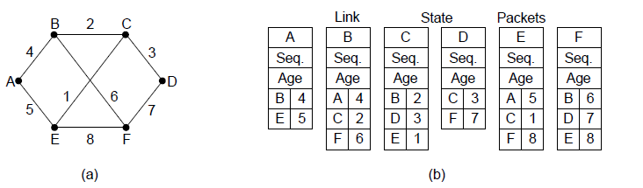
Building Link State Packets
(a) A network. (b) The link state packets for this network.

Slide 4
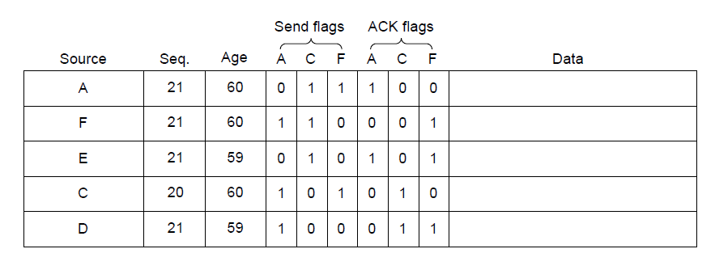
LSP Distribution
LSP database on router B
Seq. and Age used for reliable flooding
ACK LSP on received link, forward over all other links

Slide 5
In Summary (exam material)
Distance Vector:
“Routers tell their neighbours about the entire network”
Link State:
“Routers tell the entire network about their neighbourhood”

Slide 6
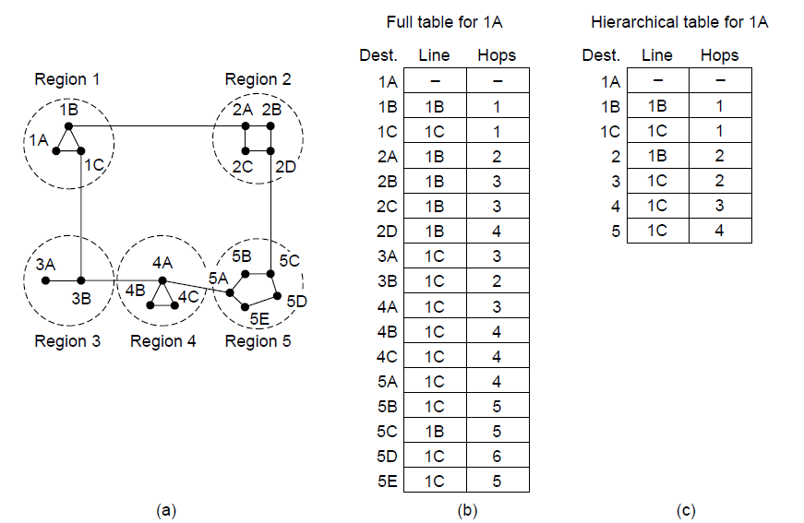
Hierarchical Routing
Partition network in regions.
Could result in longer (sub-optimal) paths to individual nodes
Reduces size of routing table
Makes computation easier/faster
Routing tables contain paths to:
Nodes within same region
Other regions (but not to nodes within them)

